Slide 1


Department of Computer Science &Engineering Artificial Intelligence & Machine Learning
A.P. Shah Institute of Technology G.B.Road,Kasarvadavli, Thane(W), Mumbai-400615
UNIVERSITY OF MUMBAI
Academic Year 2023-2024

Slide 2
”Phishing Website Detection ”
Submitted in partial fulfillment of the degree of Bachelor of Engineering(Sem-)
in
Computer Science & Engineering
Artificial Intelligence and Machine Learning
By
Tanmay Buchade | (21106031)
Sachin Sapkale | (21106026)
Shashikant Shukla | (21106024)
Devesh Sali | (21106016)
Under the Guidance of
Dr. Jaya Gupta

Slide 3

PHISHING
WEBSITE
DETECTION

Slide 4
1
INTRODUCTION
2
OBJECTIVES
TABLE OF
CONTENT
3
LITERATURE SURVEY
4
BLOCK DIAGRAM
5
TOOLS/SOFTWARE
6
OVERVIEW OF THE PROJECT
7
CONCLUSION
8
REFERENCES

Slide 5
INTRODUCTION:
It is kind of Cybercrime trying to obtain important or confidential information from users which is usually carried out by creating a counterfeit website that mimics a legitimate website.

Slide 6
Defining Phishing and Its Importance
What is Phishing?
Why is Phishing Important?
Types of Phishing Attacks
Phishing refers to the fraudulent practice of deceiving people into sharing their sensitive information, such as usernames, passwords, and credit card details, by disguising oneself as a trustworthy entity.
Phishing is a major security threat for businesses and individuals alike. It can lead to significant financial losses and damage to reputation.
Phishing attacks can take on different forms, such as spear phishing, whaling, and social engineering. It's important to be aware of them to keep yourself protected.

Slide 7
OBJECTIVE:
i. dataset collection and pre-processing;
ii. machine learning model selection and development ;
iii. development of a web-based application for detection;
iv. Integration of the developed model to web application

Slide 8
LITERATURE SURVEY TABLE
 | Sr. No | Title | Author Name | Description
 | 1. | Variants of phishing attacks and their detection techniques,, (2019) | G. Jaspher Willsie Kathrine, Paradise Mercy Praise, Eligious Kalaivani. C , A. Amrutha Rose | Various types of phishing attacks and the recent approaches to prevent the attacks are discussed. A framework to detect and prevent phishing attacks is also proposed. A combination of supervised and unsupervised machine leaming techniques was used to detect known and unknown attacks
 | 2. | Detecting Phishing Websites Using Machine Learning,(2019) | Amani Alswailem, Bashayr Alabdullah, Norah Alrumayh, Dr.Aram Alsedrani | The system is based on a machine learning particularty supervised learning. Random Forest technique is implemented due to its good performance in classification. Focus is to pursue a higher performance classifier by studying the features of phishing website and choose the better combination of them to train the dassifier.

Slide 9
LITERATURE SURVEY TABLE
 | Sr. No | Title | Author Name | Description
 | 3. | Detection and Prevention of Phishing Websites using Machine Learning Approach, (2021) | Vaibhav Patil, Pritesh Thakkar, Chirag Shah, Tushar Bhat, Prof. S. P. Godse | emphasizes the significance of machine learning in the detection and prevention of phishing websites, showcasing its evolving role in combating these cyber threats.
 | 4. | Phishing website detection based on effective machine learning approach, (2022) | Gururaj Harinahalli Lokesh, Goutham BoreGowda | highlight the growing significance of effective machine learning approaches in the detection of phishing websites. Their study underlines the pivotal role of machine learning in bolstering cybersecurity measures and proactively safeguarding users and organizations against phishing threats.

Slide 10
LITERATURE SURVEY TABLE
 | Sr. No | Title | Author Name | Description
 | 5. | Phishing Website Detection based on Multidimensional Features driven by Deep Learning,(2019) | Peng Yang, Guangzhen Zhao, Peng Zeng | underscores the crucial role of deep learning techniques in enhancing the detection of phishing websites. Their study demonstrates the potential of leveraging multidimensional features and advanced neural networks to bolster cybersecurity measures and proactively defend against phishing threats.

Slide 11
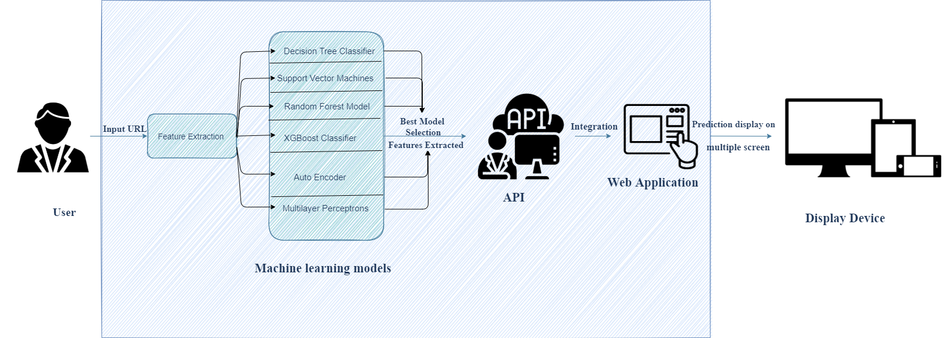
BLOCK DIAGRAM:

Slide 12
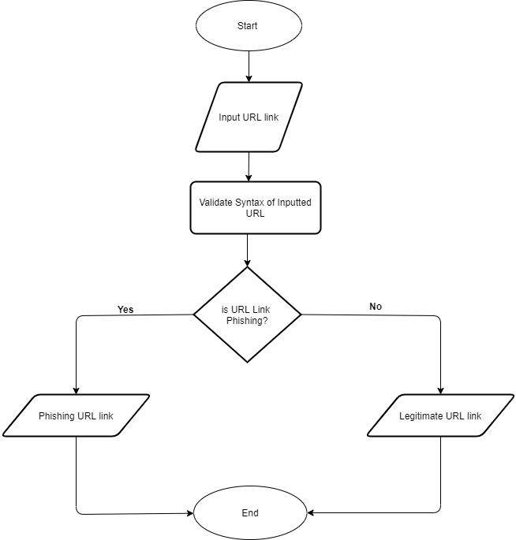
FLOW CHART:

Slide 13



TOOLS/SOFTWARE
Jupyter notebook
Pycharm
Postman
Chrome Browser

Slide 14

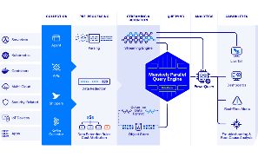
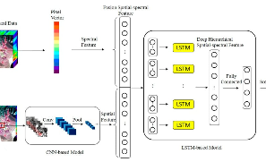
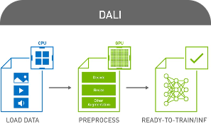
OVERVIEW OF THE PROJECT
Machine Learning
Dataset
Our project uses machine learning techniques to detect and classify phishing websites from normal ones.
We used a publicly available dataset containing features of hundreds of websites to train our models.
Feature Extraction
Preprocessing
We used various feature extraction techniques to improve the performance and accuracy of our models.
The dataset was preprocessed and cleaned to prepare it for use with our models.

Slide 15
Machine Learning Models Used
1
2
3
Decision Trees
Random Forest
Support Vector Machines
Decision trees were used as one of our baseline models. They offer easy interpretability, but can overfit and perform poorly with complicated datasets.
Random forest is a powerful ensemble learning algorithm that offers high accuracy and robustness against overfitting. It was one of the best-performing models.
SVMs are a type of supervised learning model that classifies data into one of two categories. They're known for their high accuracy and good generalization, but can be computationally expensive.

Slide 16
Future Work
1
Improvements to Models
2
Real-Time Detection
We'd like to develop a system that provides real-time detection of phishing websites by analyzing website features on the fly.
We aim to improve the performance of our models by using more advanced feature extraction techniques and exploring other types of models.
3
Collaboration
We aim to collaborate with experts in the field to enhance and expand our research.

Slide 17
CONCLUSION:
Our project demonstrates the effectiveness of using machine learning models to detect phishing websites. This has practical applications in the field of cybersecurity and can help businesses and individuals stay protected.

Slide 18
REFERENCES:
Cyber attacker hacking into email server by Freepik. (n.d.). Retrieved from https://www.freepik.com/free-vector/cyber-attacker-hacking-into-email-server_5259895.htm#page=1&query=cyber%20phishing&position=2
People connecting jigsaw pieces of a head together by Freepik. (n.d.). Retrieved from https://www.freepik.com/free-vector/people-connecting-jigsaw-pieces-head-together_3425145.htm#page=1&query=knowledge&position=4
Group of people holding question mark icons by Freepik. (n.d.). Retrieved from https://www.freepik.com/free-vector/group-people-holding-question-mark-icons_3530048.htm#page=1&query=PROBLEM&position=12
Golden cup with arrow hitting in the target center by Freepik. (n.d.). Retrieved from https://www.freepik.com/free-vector/golden-cup-with-arrow-hitting-target-center_1311358.htm#page=1&query=AIM&position=25
Affective computing abstract concept illustration by Freepik. (n.d.).Retrieved from https://www.freepik.com/free-vector/affective-computing-abstract-concept-illustration_11668804.htm#page=1&query=machine%20learning&position=17

